Slide 1




Fundamentals Level @ SoftUni
Welcome to Software University
SoftUni Team
Technical Trainers
Software University
http://softuni.bg

Slide 2
SoftUni: Levels, Modules, Schedule
Programming Basics
2 months
6 credits
Programming Fundamentals
36 credits
6 months
Advanced C#
Object-Oriented Programming
High-Quality Code
Java Basics
Teamwork and Personal Skills
Web Front-End
Back-End
36 credits
36 credits
HTML + CSS + WordPress
JavaScript Basics
Advanced JavaScript
Databases
Database Applications
Web Services and Cloud
6 months
JavaScript Applications
JavaScript Frameworks
PHP Web Development
ASP.NET MVC Web Development

Slide 3
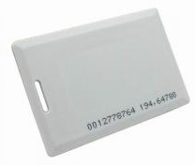
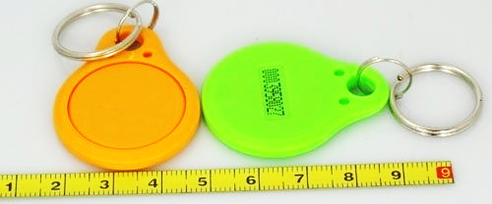
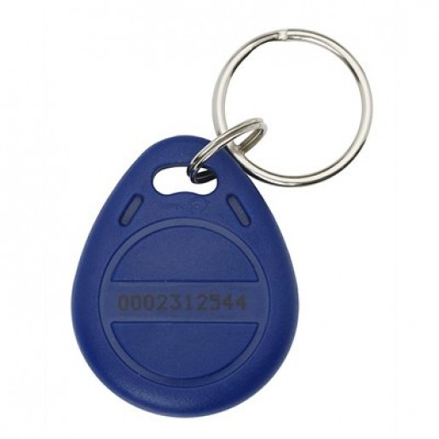
Check-In @ SoftUni
Onsite students at SoftUni should check-in when they come
We use standard 125 KHz RFID chips / cards
Check-in device (reader) is available at the SoftUni reception
Use your own chip / card or take a chip from SoftUni

Slide 4
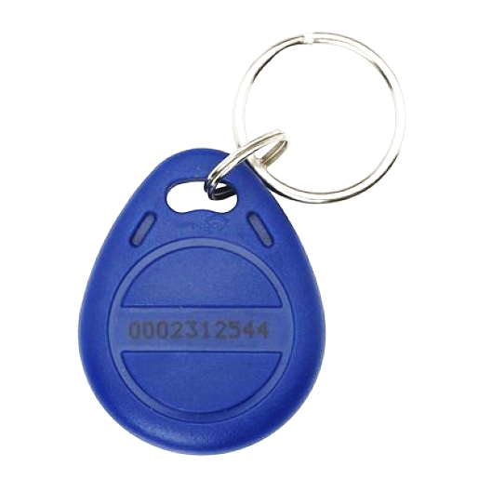
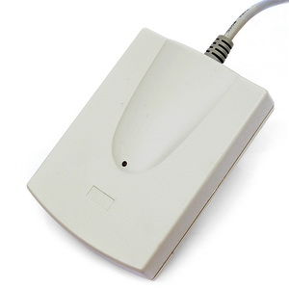
Your RFID Chip
Students can either
Take RFID chip from SoftUni
Or use their own chip / card
Register your chip number in your SoftUni profile: https://softuni.bg/users/profile/show
Check-in at the reception every time when you come
See your last visits in your profile: https://softuni.bg/users/profile/show

Slide 5
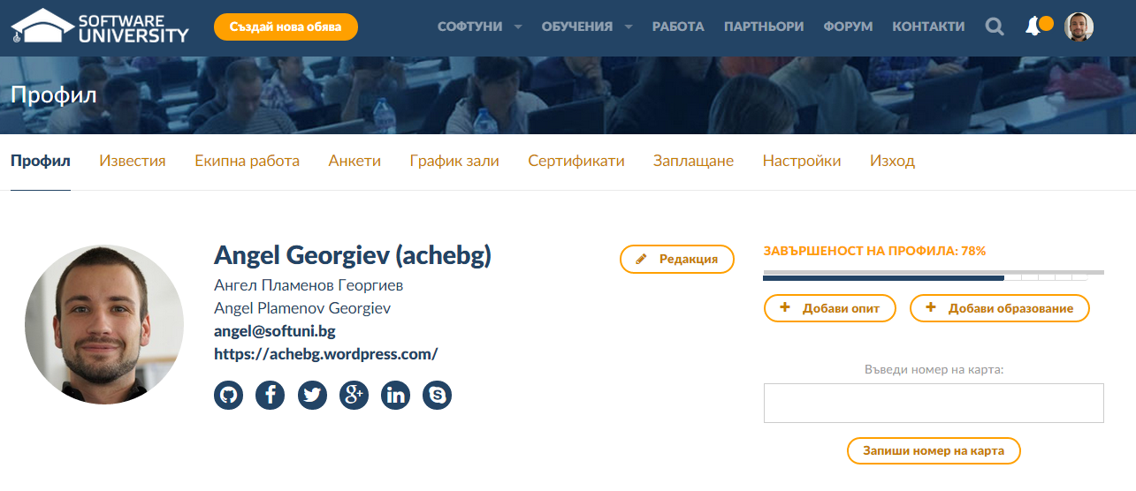
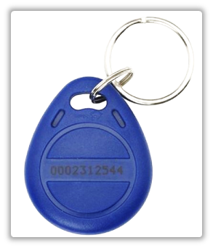
Registering Your Chip – Step 1
Enter the chip number in this box
This is your chip number

Slide 6
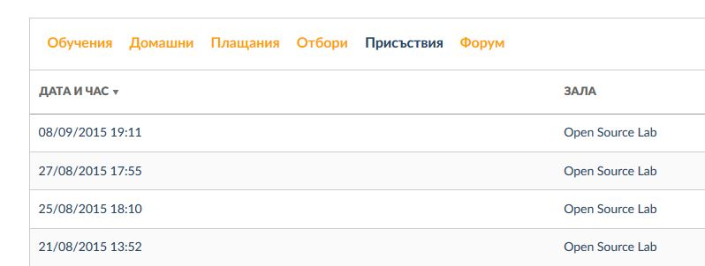
Registering Your Chip – Step 2
View your latest attendances
go to softuni.bg/users/profile/show
or just navigate to your profile

Slide 7
Free Licenses from Our Partners
SoftUni has partnerships, to provide free educational licenses to all its students (after level "Fundamentals")
From JetBrains
ReSharper – powerful add-on for Visual Studio for C# developers
WebStorm – powerful IDE for JavaScript developers
PhpStorm – powerful IDE for PHP developers
From SuperHosting.bg
Free hosting for your site / blog

Slide 8
Free Licenses from Our Partners (2)
From Microsoft
Free access to Windows Azure cloud
From Laptop.bg
5% discount for laptops and tablets

Slide 9










Software University
https://softuni.bg

Slide 10
License
This course (slides, examples, demos, videos, homework, etc.) is licensed under the "Creative Commons Attribution-NonCommercial-ShareAlike 4.0 International" license
Attribution: this work may contain portions from
"Fundamentals of Computer Programming with C#" book by Svetlin Nakov & Co. under CC-BY-SA license
"C# Part I" course by Telerik Academy under CC-BY-NC-SA license

Slide 11





Free Trainings @ Software University
Software University Foundation – softuni.org
Software University – High-Quality Education, Profession and Job for Software Developers
softuni.bg
Software University @ Facebook
facebook.com/SoftwareUniversity
Software University @ YouTube
youtube.com/SoftwareUniversity
Software University Forums – forum.softuni.bg

